Slide 1


Workshop on Monte Carlo Simulations
Mohammad Soroush Barhaghi†, Younes Nejahi‡, Loren Schwiebert‡, and Jeffrey Potoff†
† Department of Chemical Engineering & Materials Science, College of Engineering,
‡ Department of Computer Science, College of Engineering, Wayne State University, Detroit, MI, USA 48202
Notes:
1- MC simulation engine
2- Developed by potoff group & schwibert
3- Developed for running on CPU and GPU
4- CPU system size < 10,000
5- GPU system size > 10,000

Slide 2
Tutorial files
On GitHub
Git clone https://github.com/msoroush/Workshop.git
https://github.com/msoroush/Workshop
To run example: copy GOMC_CPU_NVT from GOMC/bin to Workshop/NVT/argon/argon_T_120K

Slide 3
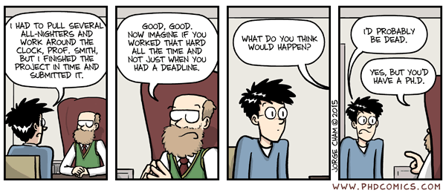
Acknowledgements
Mohammad Soroush Barhaghi, Jason Mick, Younes Nejahi, Kamel Rushaidat, Runxuan Jiang, Brock Jackman, Navendu Bhatnagar, Ganesh Kamath, Loren Schwiebert
National Science Foundation CBET-1066661, ACI-1148168, ACI-1642406
NVIDIA, Silicon Mechanics
Grid Computing at WSU

Slide 4
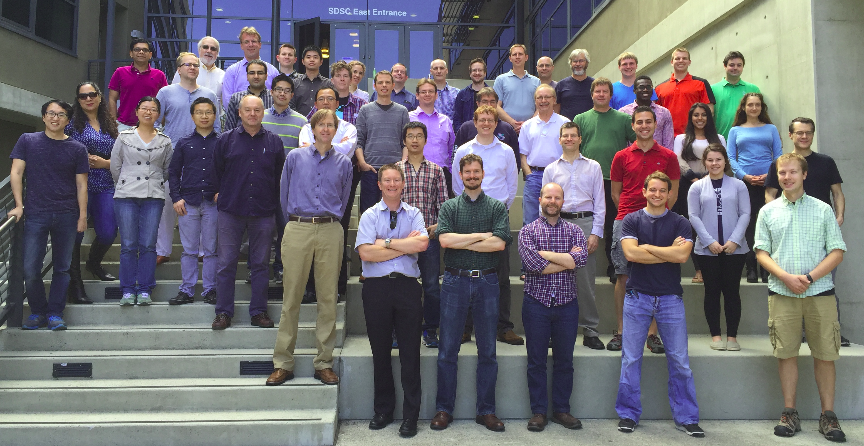

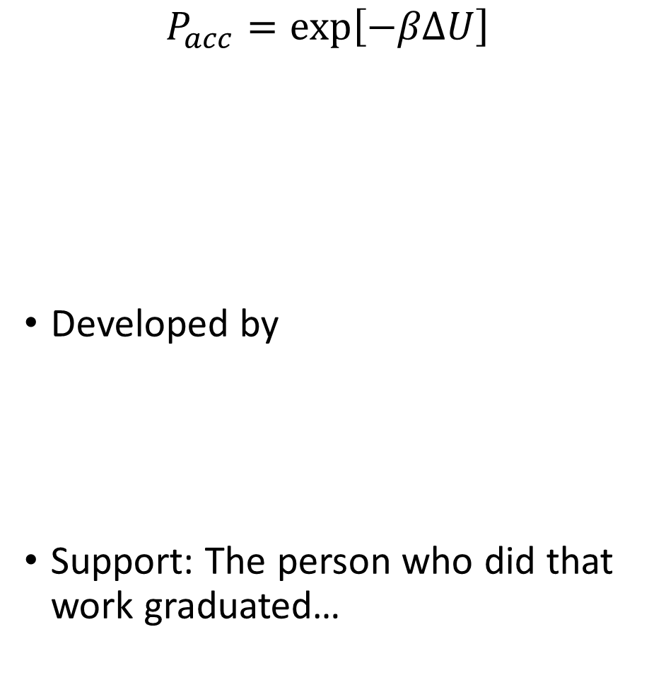
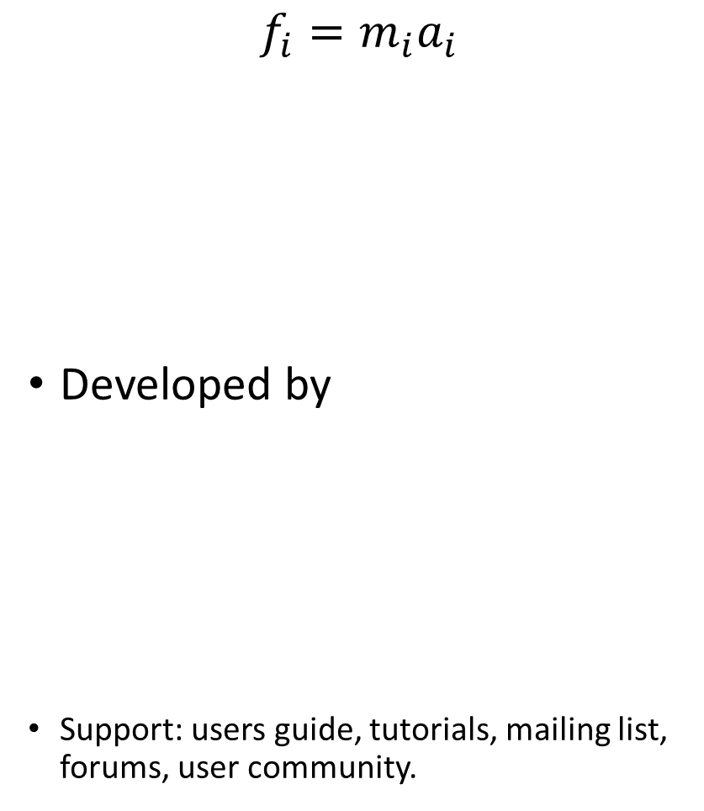
Monte Carlo
Molecular dynamics
$$P_{acc}=\exp\left[−βΔU\right]$$
Developed by
Support: The person who did that work graduated…
$$f_{i}=m_{i}a_{i}$$
Developed by
Support: users guide, tutorials, mailing list, forums, user community.
Notes:
Transition: so why would one want to use Monte Carlo? Present applications where the method is valuable. Mention NSF vs. NIH funding disparity. People moving away from Monte Carlo, even if it’s the best method because of the lack of software, and need to write your own code.

Slide 5
Notes:
Issue of long time scale, slow diffusion. MARTINI already significantly over estimates self-diffusivity. For all-atom models this will take an extraordinarily long time.

Slide 6
Notes:
Rapid screening MOFs for methane storage

Slide 7
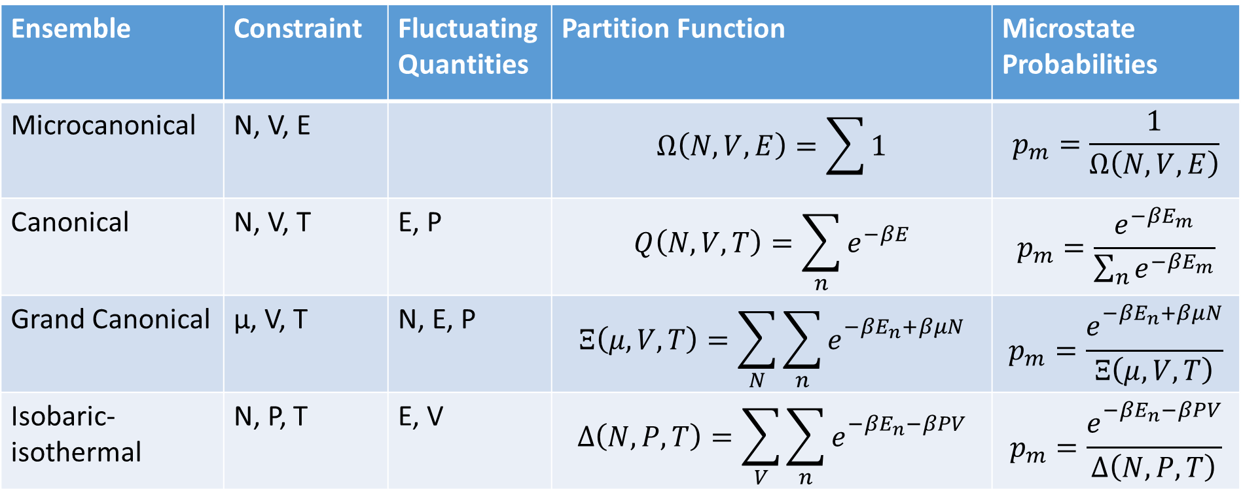
Ensemble
A collection of microstates subject to external (macroscopic) constraints.
Ensemble | Constraint | Fluctuating Quantities | Partition Function | Microstate Probabilities
Microcanonical | N, V, E |  | $$Ω\left(N,V,E\right)=\sum{1}$$ | $$p_{m}=\frac{1}{Ω\left(N, V, E\right)}$$
Canonical | N, V, T | E, P | $$Q\left(N,V,T\right)=\sum_{n}{e^{−βE}}$$ | $$p_{m}=\frac{e^{−βE_{m}}}{\sum_{n}{e^{−βE_{m}}}}$$
Grand Canonical | µ, V, T | N, E, P | $$Ξ\left(μ,V, T\right)=\sum_{N}{\sum_{n}{e_{}^{−βE_{n}+βμN}}}$$ | $$p_{m}=\frac{e_{}^{−βE_{n}+βμN}}{Ξ\left(μ,V, T\right)}$$
Isobaric-isothermal | N, P, T | E, V | $$Δ\left(N,P, T\right)=\sum_{V}{\sum_{n}{e_{}^{−βE_{n}−βPV}}}$$ | $$p_{m}=\frac{e_{}^{−βE_{n}−βPV}}{Δ\left(N,P, T\right)}$$

Slide 8
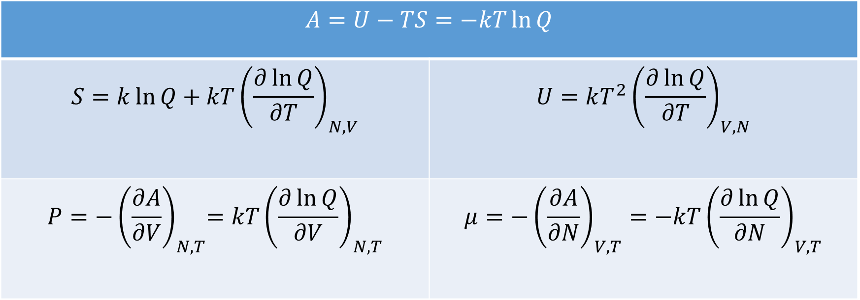
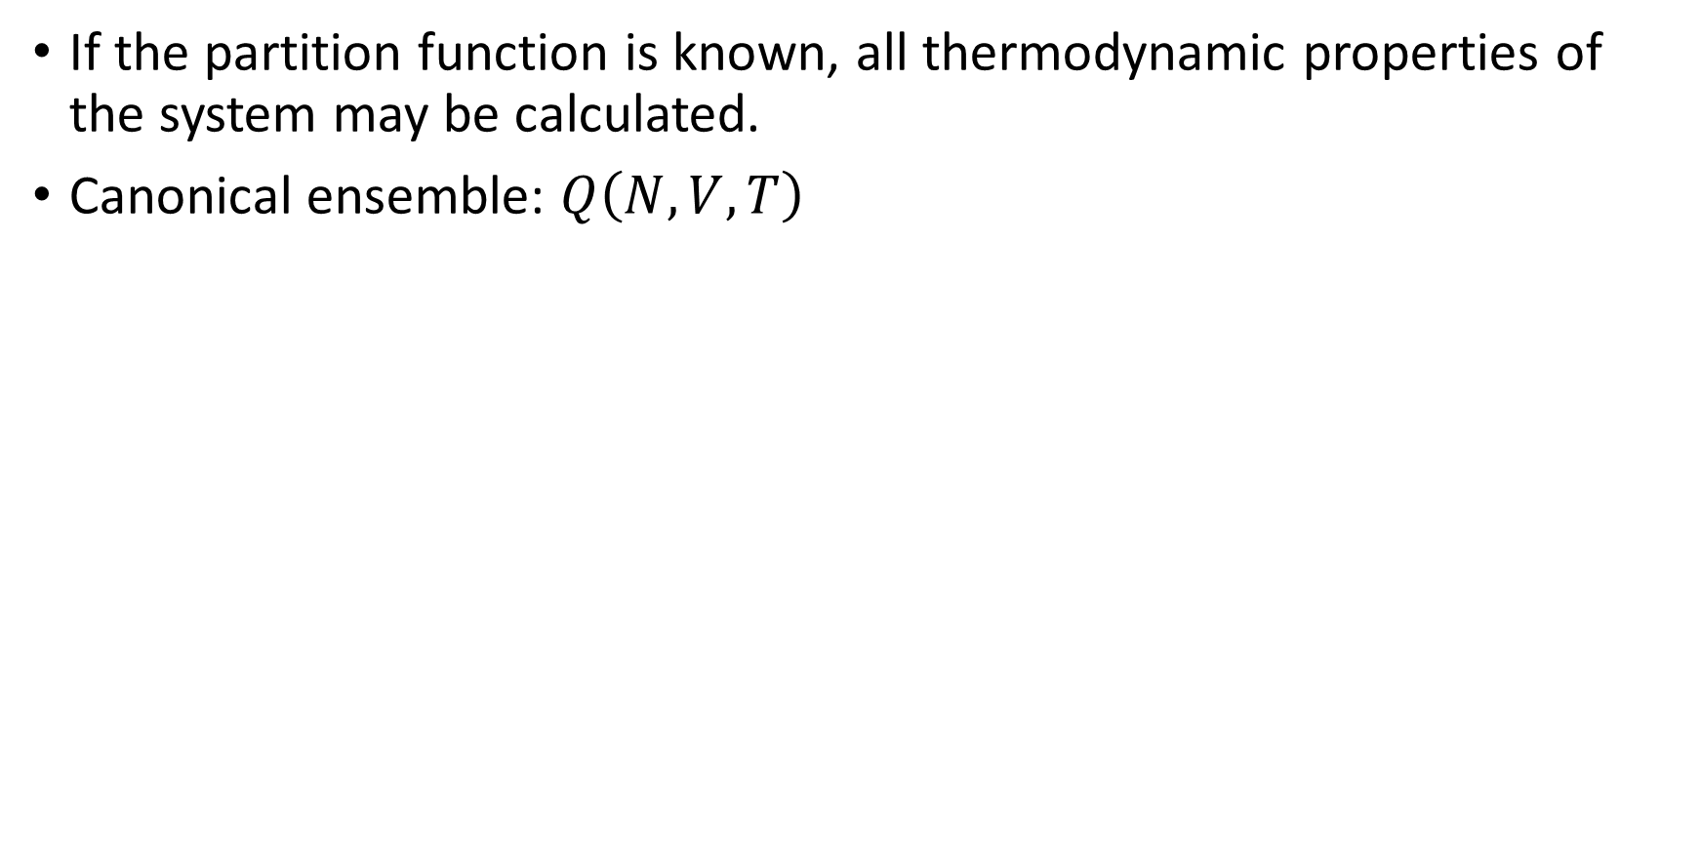
Partition Functions
If the partition function is known, all thermodynamic properties of the system may be calculated.
Canonical ensemble: $Q\left(N, V, T\right)$
$$A=U−TS=−kT\ln{Q}$$
$$S=k\ln{Q+kT{\left(\frac{∂\ln{Q}}{∂T}\right)}_{N,V}}$$ | $$U=kT^{2}{\left(\frac{∂\ln{Q}}{∂T}\right)}_{V, N}$$
$$P={−\left(\frac{∂A}{∂V}\right)}_{N, T}=kT{\left(\frac{∂\ln{Q}}{∂V}\right)}_{N, T}$$ | $$μ=−{\left(\frac{∂A}{∂N}\right)}_{V,T}=−kT{\left(\frac{∂\ln{Q}}{∂N}\right)}_{V,T}$$

Slide 9
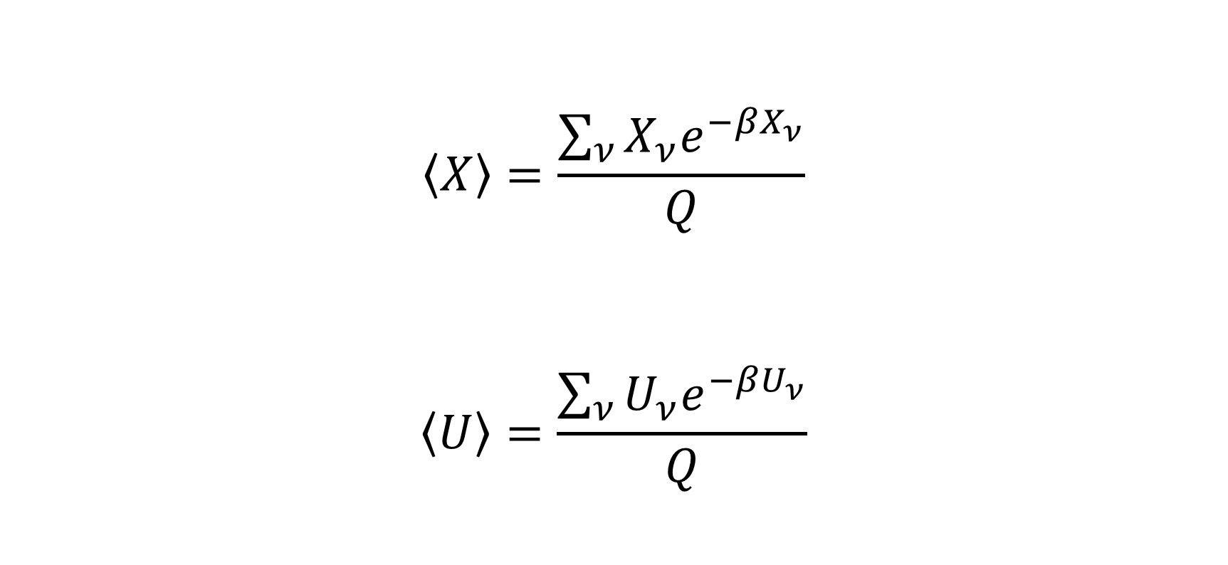
Averages
$$\left\langle X\right\rangle =\frac{\sum_{ν}{X_{ν}e^{−βX_{ν}}}}{Q}$$
$$\left\langle U\right\rangle =\frac{\sum_{ν}{U_{ν}e^{−βU_{ν}}}}{Q}$$

Slide 10
Markov Chains
Stochastic process where the state of the system changes at random, with no memory of previous states.
Assuming the system is in configuration a
Configuration a is perturbed randomly to generate a new atomic configuration b, e.g. molecule displacement.
The proposed configuration is accepted or rejected.
The process is repeated over and over again.
The trajectory includes the states of the system after each acceptance or rejection, but not the proposed configurations.

Slide 11
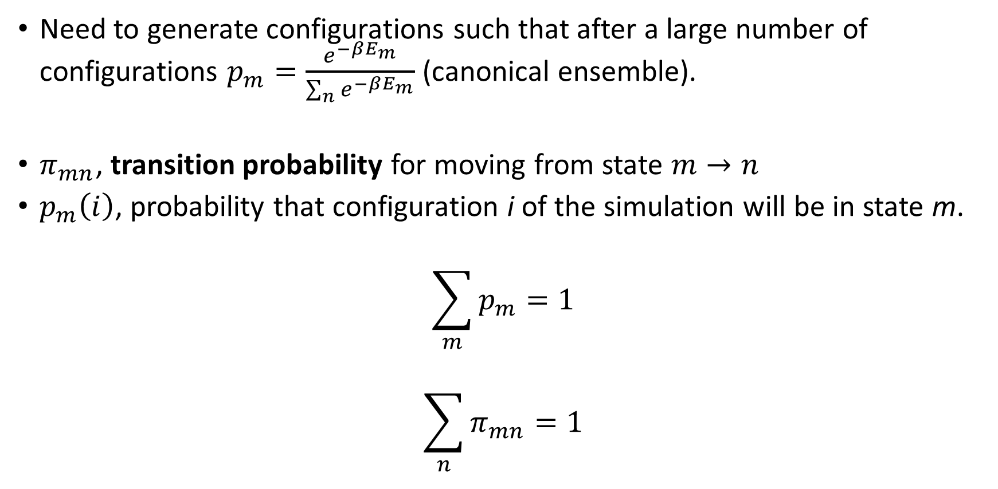
Detailed Balance
Need to generate configurations such that after a large number of configurations $p_{m}=\frac{e^{−βE_{m}}}{\sum_{n}{e^{−βE_{m}}}}$ (canonical ensemble).
$π_{mn}$, transition probability for moving from state $m→n$
$p_{m}\left(i\right)$, probability that configuration i of the simulation will be in state m.
$$\sum_{m}{p_{m}=1}$$
$$\sum_{n}{π_{mn}=1}$$

Slide 12
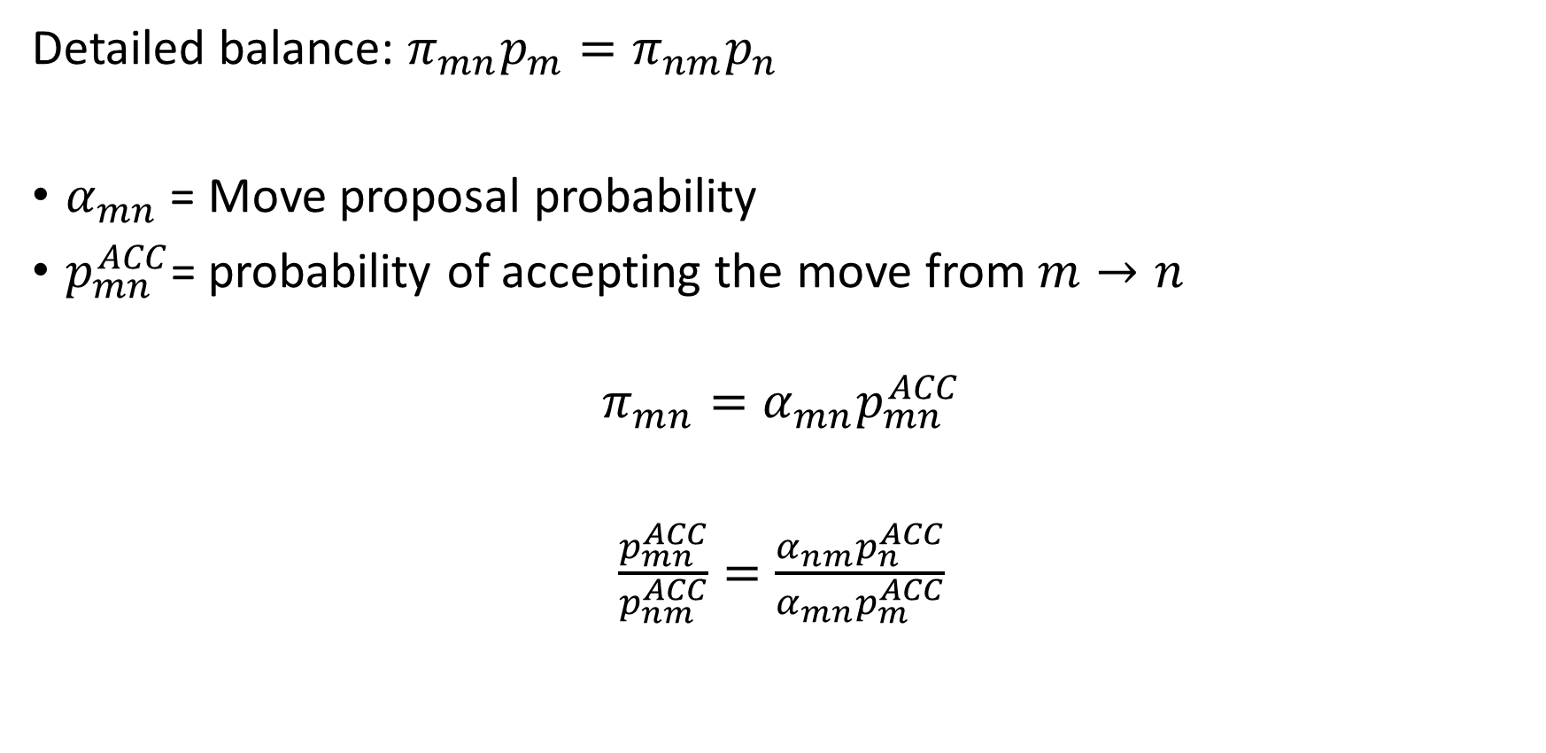
Detailed Balance
Detailed balance: $π_{mn}p_{m}=π_{nm}p_{n}$
$α_{mn}$ = Move proposal probability
$p_{mn}^{ACC}$= probability of accepting the move from $m→n$
$$π_{mn}=α_{mn}p_{mn}^{ACC}$$
$\frac{p_{mn}^{ACC}}{p_{nm}^{ACC}}=\frac{α_{nm}p_{n}^{ACC}}{α_{mn}p_{m}^{ACC}}$

Slide 13
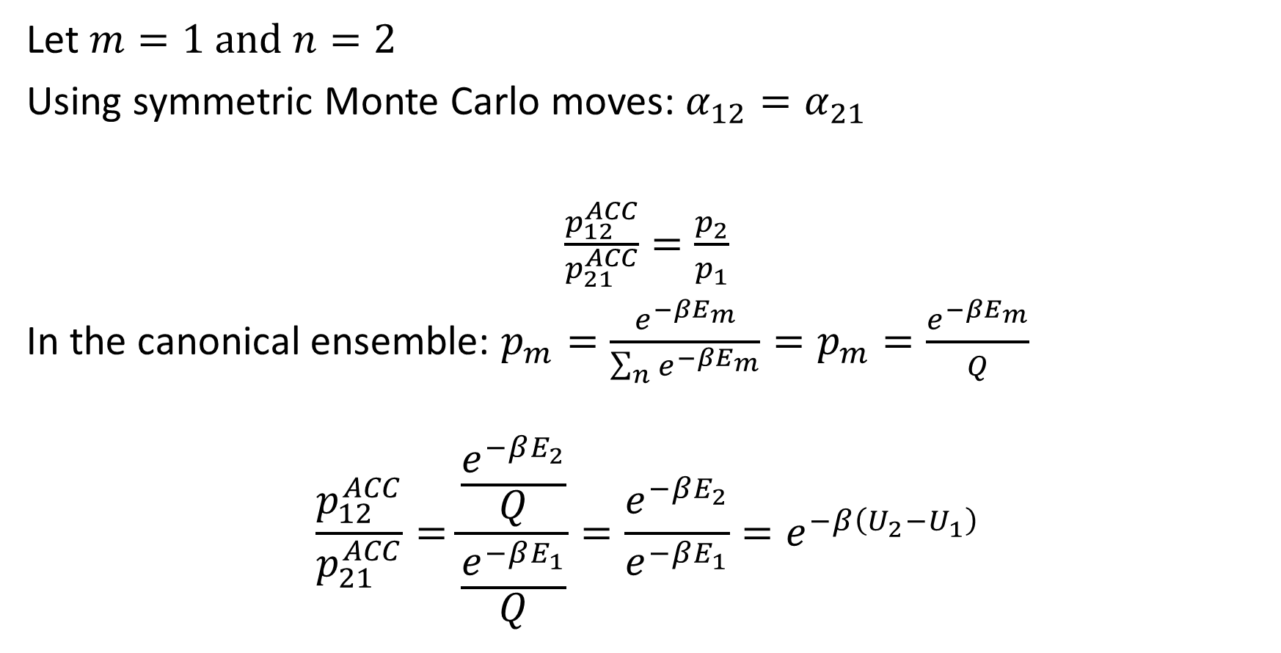
Detailed Balance
Let $m=1 and n=2$
Using symmetric Monte Carlo moves: $α_{12}=α_{21}$
$\frac{p_{12}^{ACC}}{p_{21}^{ACC}}=\frac{p_{2}}{p_{1}}$
In the canonical ensemble: $p_{m}=\frac{e^{−βE_{m}}}{\sum_{n}{e^{−βE_{m}}}}=p_{m}=\frac{e^{−βE_{m}}}{Q}$
$$\frac{p_{12}^{ACC}}{p_{21}^{ACC}}=\frac{\frac{e^{−βE_{2}}}{Q}}{\frac{e^{−βE_{1}}}{Q}}=\frac{e^{−βE_{2}}}{e^{−βE_{1}}}=e^{−β\left(U_{2}−U_{1}\right)}$$

Slide 14
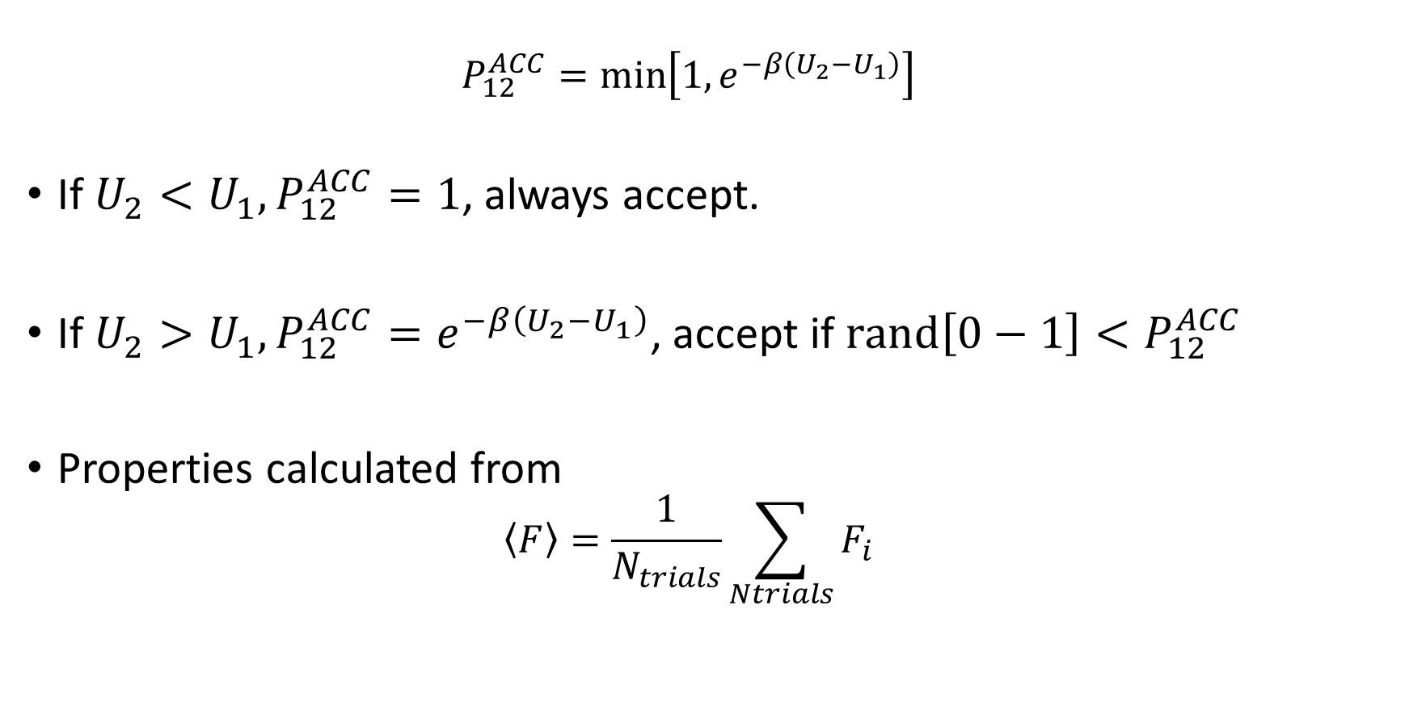
Detailed Balance
$$P_{12}^{ACC}=\min\left[1,e^{−β\left(U_{2}−U_{1}\right)}\right]$$
If $U_{2}<U_{1},P_{12}^{ACC}=1$, always accept.
If $U_{2}>U_{1},P_{12}^{ACC}=e^{−β\left(U_{2}−U_{1}\right)}$, accept if ${rand\left[0−1\right]<P}_{12}^{ACC}$
Properties calculated from
$$\left\langle F\right\rangle =\frac{1}{N_{trials}}\sum_{Ntrials}{F_{i}}$$

Slide 15
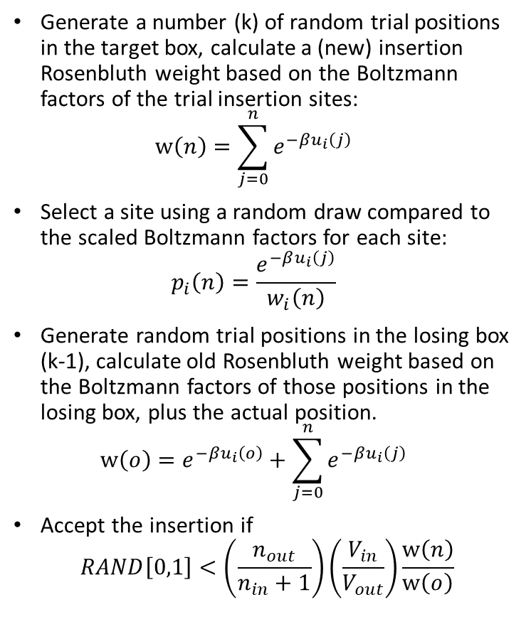
Configurational-Bias Monte Carlo
Generate a number (k) of random trial positions in the target box, calculate a (new) insertion Rosenbluth weight based on the Boltzmann factors of the trial insertion sites: $w\left(n\right)=\sum_{j=0}^{n}{e^{−βu_{i}\left(j\right)}}$
Select a site using a random draw compared to the scaled Boltzmann factors for each site: $p_{i}\left(n\right)=\frac{e^{−βu_{i}\left(j\right)}}{w_{i}\left(n\right)}$
Generate random trial positions in the losing box (k-1), calculate old Rosenbluth weight based on the Boltzmann factors of those positions in the losing box, plus the actual position. $w\left(o\right)=e^{−βu_{i}\left(o\right)}+\sum_{j=0}^{n}{e^{−βu_{i}\left(j\right)}}$
Accept the insertion if
$$RAND\left[0,1\right]<\left(\frac{n_{out}}{n_{in}+1}\right)\left(\frac{V_{in}}{V_{out}}\right)\frac{w\left(n\right)}{w\left(o\right)}$$
Trial insertion
Existing molecules

Slide 16
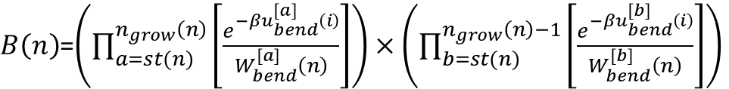
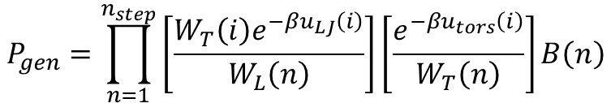
Coupled-Decoupled Configurational Bias
For n sites grown off a branch point n_{grow}(n)=n-1
$B\left(n\right)$=$\left(\prod_{a=st(n)}^{n_{grow}\left(n\right)}{\left[\frac{e^{−βu_{bend}^{[a]}\left(i\right)}}{W_{bend}^{[a]}\left(n\right)}\right]}\right)×\left(\prod_{b=st(n)}^{n_{grow}\left(n\right)−1}{\left[\frac{e^{−βu_{bend}^{[b]}\left(i\right)}}{W_{bend}^{[b]}\left(n\right)}\right]}\right)$
# of growth steps
where each step regrows all segments from a branch point
These angles ([b]) are spatially dependent on the picks from [a].
These angles ([a]) are fully independent from a spatial perspective
Torsion is coupled to nonbonded energy
i₁
a₁
t
$$P_{gen}=\prod_{n=1}^{n_{step}}{\left[\frac{W_{T}\left(i\right)e^{−βu_{LJ}\left(i\right)}}{W_{L}\left(n\right)}\right]\left[\frac{e^{−βu_{tors}\left(i\right)}}{W_{T}\left(n\right)}\right]B\left(n\right)}$$
p
b₁
f
i₂
a₂
i₃
Picking for bond angle is decoupled.
Martin and Siepmann, J. Phys. Chem B, 103, 4508 (1999)

Slide 17
Introduction to GOMC

Slide 18
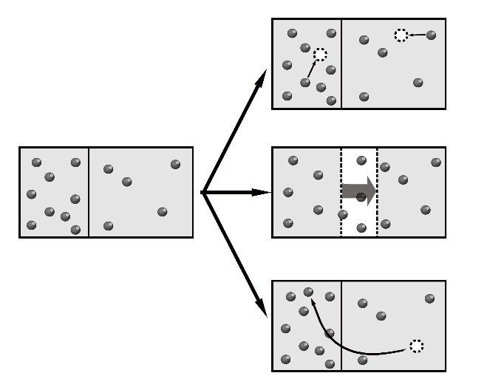
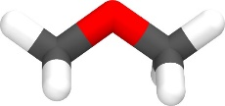
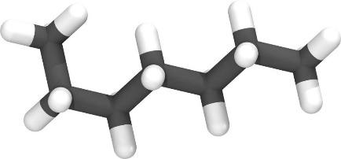

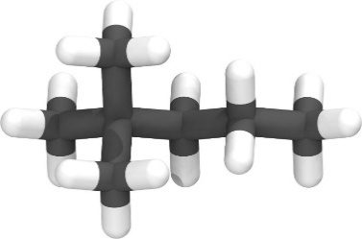
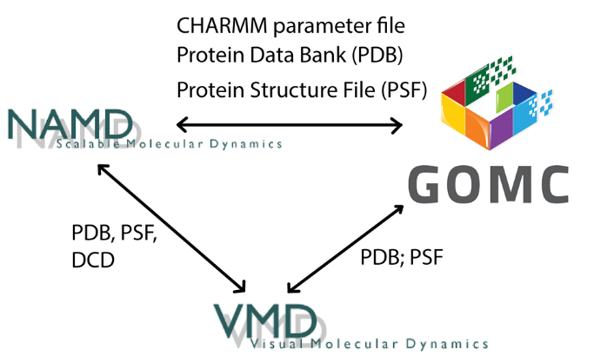
NVT, NPT,
GCMC, and GEMC
Linear, Branched,
Polar
Martini
Charmm
OPLS
Mie
Custom Potential
Moves Supported:
Displacement
Rotation
Swap
Intra-Swap
Volume:
Const. Ratio
Const. Area
Parallelization
CPU
OpenMP
GPU
OpenMP + GPU

Slide 19

GOMC I/O
PDB
PDB
PSF
PSF
Log
Parameter
Block Averages
Control
GCMC: Histogram

Slide 20
GOMC I/O: Input
PDB
Coordinates of all atoms
PSF
Connectivity between atoms and partial charges.
Maps atom names to atom types
Parameter
Bonded and non-bonded parameters for all atoms,
bonds, angles and dihedrals
Control
Simulation run conditions: box size, temperature
Move ratios, parameter files, etc.

Slide 21
GOMC I/O: Output
MOVE_<box number>: move statistics
ENER_<box number>: energies
STAT_<box number>: density
Data are stored in columns, making them straightforward to extract with awk.
Quantities instantaneous values, and are defined with MTITLE, ETITLE and STITLE headers near the beginning of the log file.

Slide 22
NVT Monte Carlo Example
Simulation of argon at 120 K and at saturated liquid density.
Use the example files to run simulation to calculate the average energy and radial distribution function.
Next step: Build input files for n-butane and rerun the simulation at 300 K and 0.567 g/cm³.

Slide 23
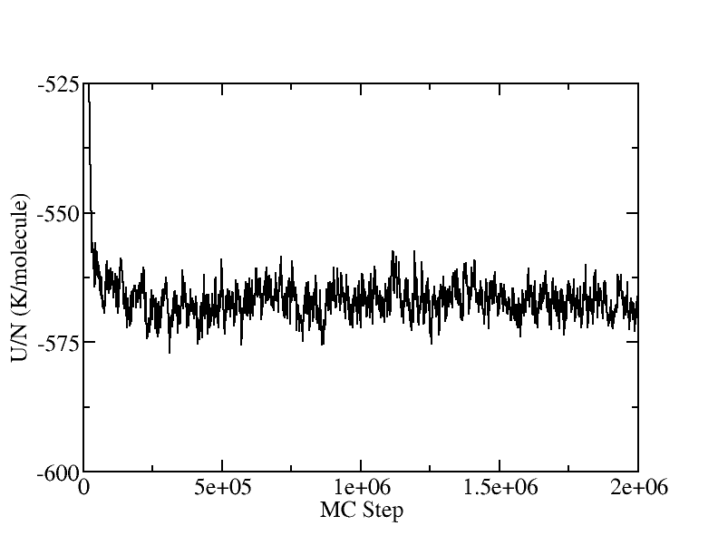
GOMC I/O: Output
Extract data using awk
awk ‘/ENER_0/ {print $2, $3}’ argon_120.log > energy.dat
grep “ENER_0” argon_120.log | awk {print $2, $3}’ > energy.dat

Slide 24
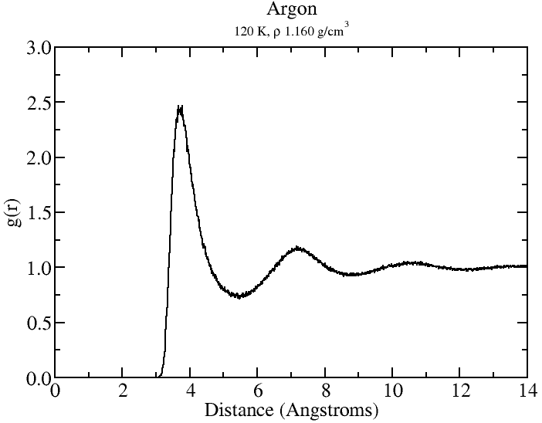
GOMC: RDF
package require pbctools
#load PDB and set box size
mol new Argon_NVT_T_120K_BOX_0.pdb waitfor all
pbc set {38.527 38.527 38.527}
set nframes [molinfo top get numframes]
set sel1 [atomselect top "resname AR"]
set sel2 [atomselect top "resname AR"]
#calculate RDF on multicore
set rdf [measure gofr $sel1 $sel2 delta 0.01
rmax 14.0 usepbc 1 selupdate 0 first 0 last
[expr {$nframes-1}] step 1]
#organize data for printing
set ri [lindex $rdf 0]
set gr [lindex $rdf 1]
set rdf_out [open "rdf.dat" "w"]
foreach val1 $ri val2 $gr {
puts $rdf_out "$val1\t$val2"
}
close $rdf_out
exit

Slide 25
Using the restart file
#########################
# enable, step
#########################
Restart false
####################################
# INPUT PDB FILES
####################################
Coordinates 0 ../build/START_BOX_0.pdb
####################################
# INPUT PSF FILES
####################################
Structure 0 ../build/START_BOX_0.psf
#########################
# enable, step
#########################
Restart true
####################################
# INPUT PDB FILES
####################################
Coordinates 0 ./Argon_NVT_T_120K_BOX_0_restart.pdb
####################################
# INPUT PSF FILES
####################################
Structure 0 ./Argon_NVT_T_120K_merged.psf

Slide 26
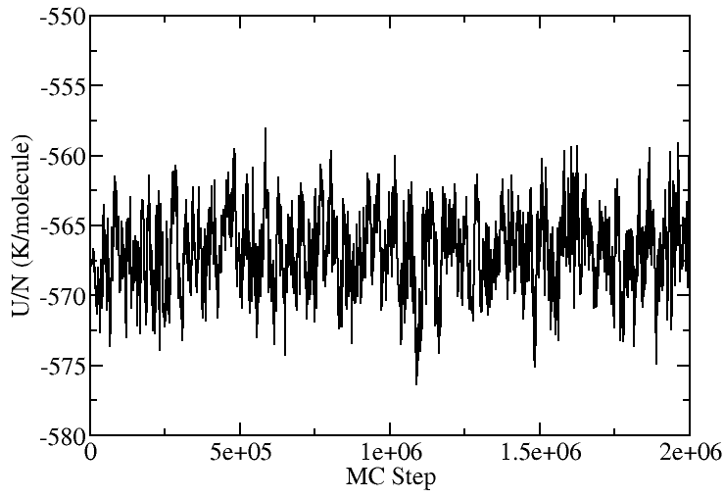
Using the restart file
Packmol initial configuration
Restart initial configuration
Restart file is very useful for systems where the density fluctuates (GEMC, GCMC).

Slide 27
Building new molecules
Need atomic coordinates of the molecule of interest in PDB format.
Entry in topology file defining bonds between atoms, map of atom names to atom types, and partial charges.
PDB
Topology
PDB-all, PSF
Packmol
PSFGEN

Slide 28
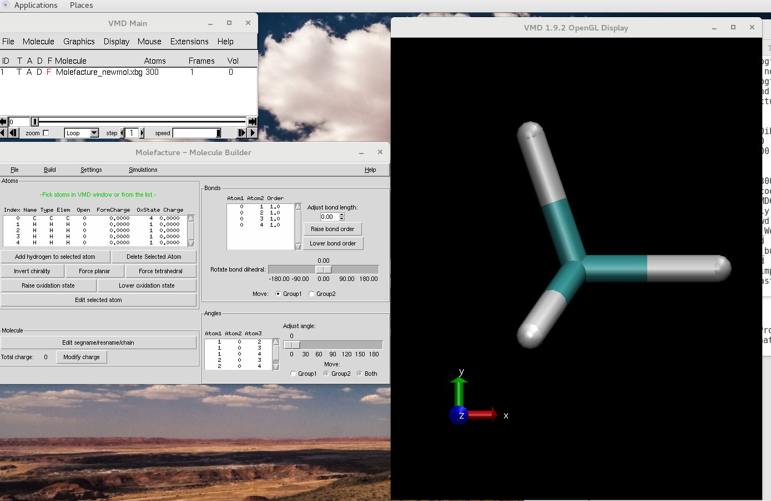
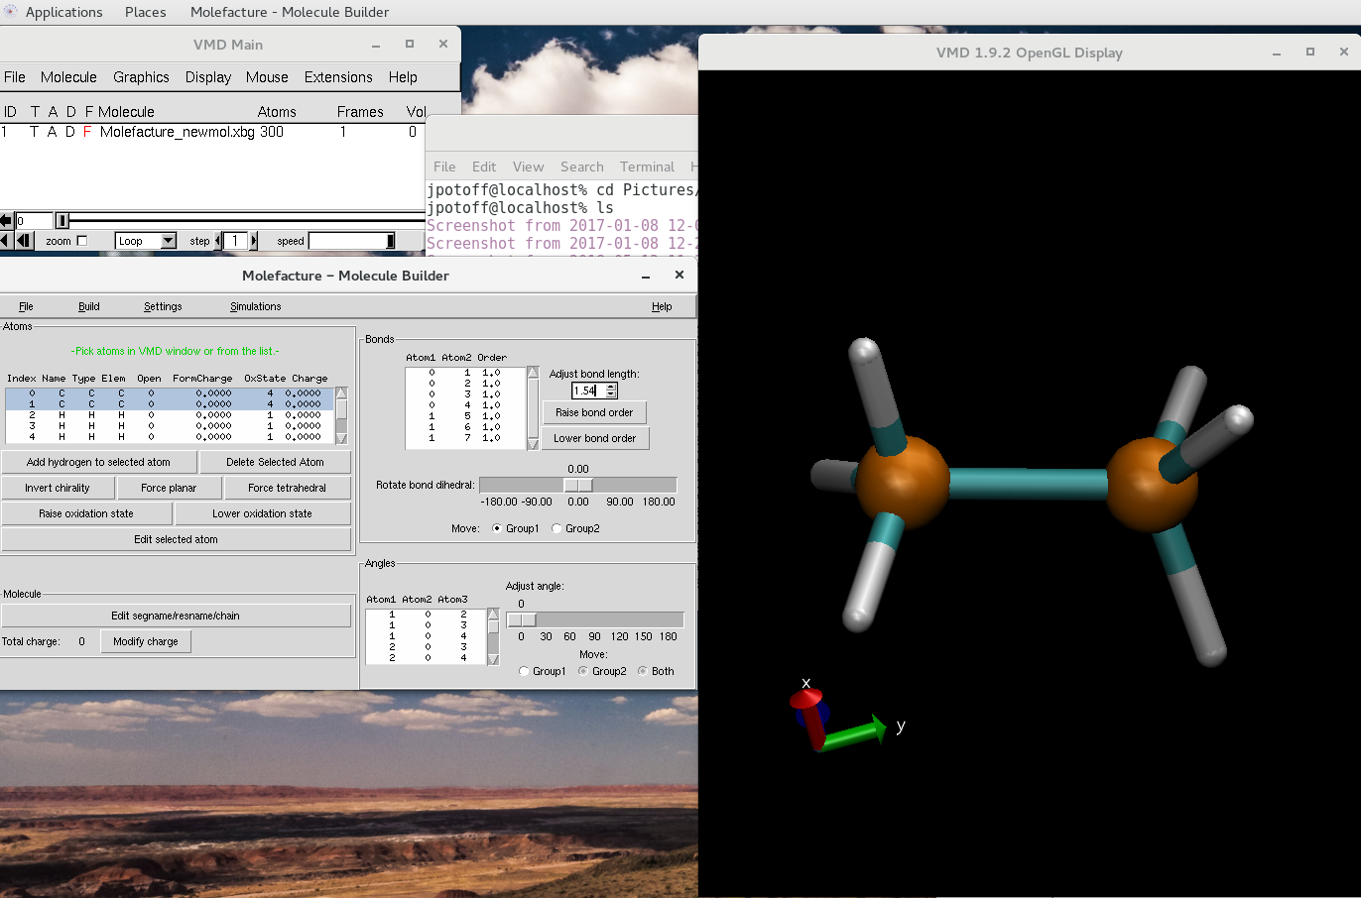
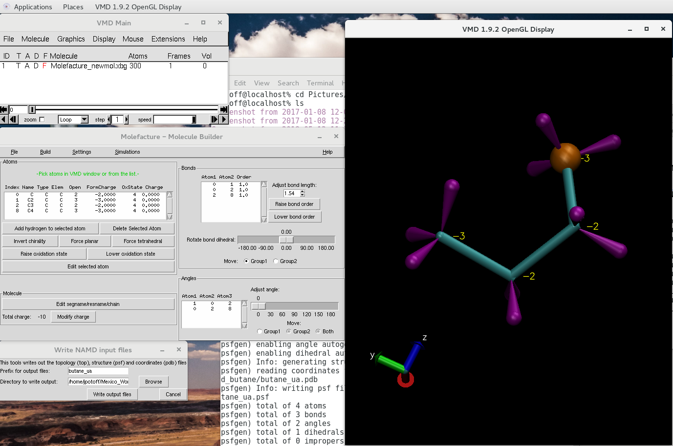
Build single molecule PDB (butane)
VMD->extensions-> modeling -> molefacture
New molecule from fragment
Select “methane”
Select hydrogen atom
Build->replace hydrogen with fragment
Select methyl
Fix bond length
Select both C atoms and use bond length tool on the upper right panel.
Repeat until we have butane
For UA force field, delete all hydrogen atoms
Edit atom names and types (“edit selected atom”).

Slide 29
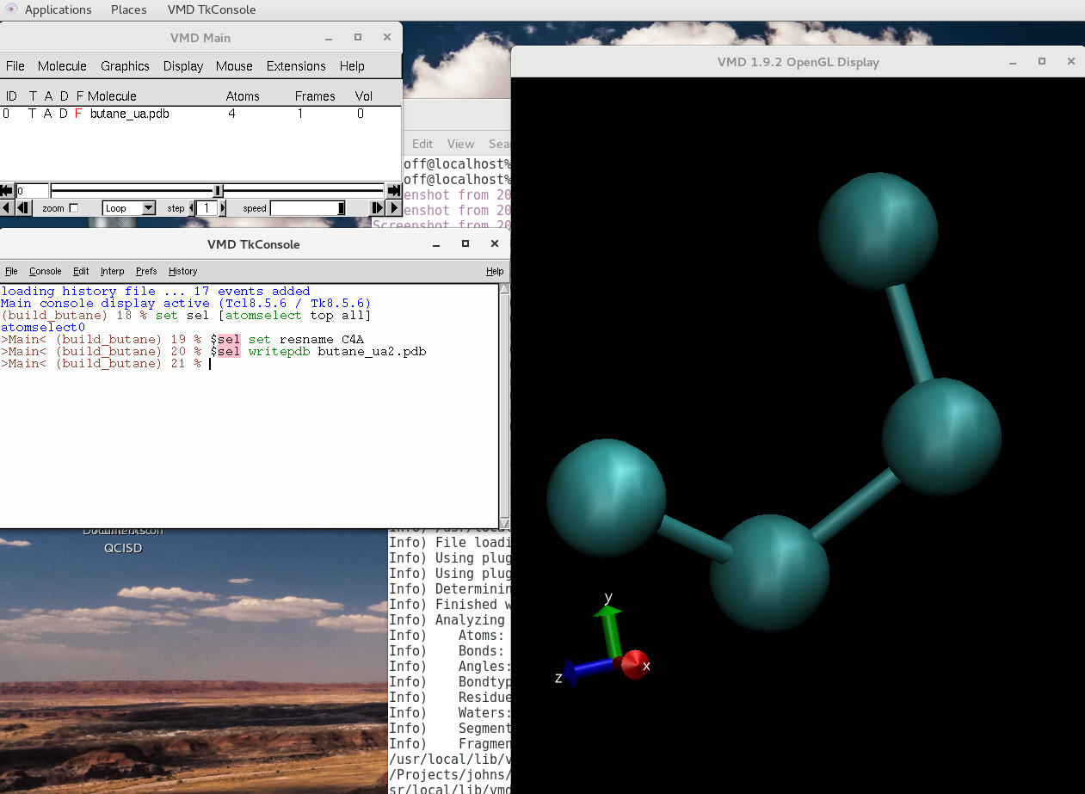
Preparing initial configuration
Assign resname
Molecule->edit segname/resname/chain
Set to C4A
Save PDB
Save topology file.

Slide 30
Topology file
RESI C4A 0.00 ! n-butane
GROUP
ATOM C1 CH3 0.00 ! C1 C3
ATOM C2 CH2 0.00 ! \ / \
ATOM C3 CH2 0.00 ! C2 C4
ATOM C4 CH3 0.00 !
BOND C1 C2 C2 C3 C3 C4
PATCHING FIRS NONE LAST NONE
Defines residue name
Maps atom name to atom type
Column 3 is the partial charge
Defines bonds between pairs of atoms.

Slide 31
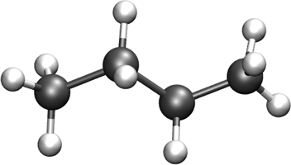
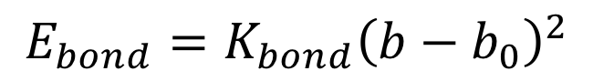
Parameter file: Bonds
EXOTIC
CHARMM
BONDS
!
!V(bond) = Kb(b - b0)**2
!
!atom type Kb(K/mole/A**2) b0 (A) description
CH3 CH3 9999999999 1.540 ! Fixed.
CH3 CH2 9999999999 1.540 ! Fixed.
CH2 CH2 9999999999 1.540 ! Fixed.
BONDS
!
!V(bond) = Kb(b - b0)**2
!
!atom type Kb(Kcal/mol /A**2) b0 (A) description
CH3 CH3 9999999999 1.540 ! Fixed.
CH3 CH2 9999999999 1.540 ! Fixed.
CH2 CH2 9999999999 1.540 ! Fixed.
$$E_{bond}=K_{bond}{\left(b−b_{0}\right)}^{2}$$

Slide 32
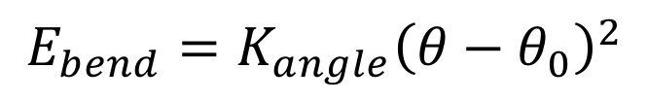
Parameter file: Angles
EXOTIC
CHARMM
ANGLES
!
!V(angle) = Ktheta(Theta - Theta0)**2!
!
!atom types Ktheta(K/mole/rad**2) Theta0(degree)
CH3 CH2 CH3 31250 114.00 !
CH3 CH2 CH2 31250 114.00 !
CH2 CH2 CH2 31250 114.00 !
ANGLES
!
!V(angle) = Ktheta(Theta - Theta0)**2!
!
!atom types Ktheta(Kcal/mole/rad**2) Theta0(degree)
CH3 CH2 CH3 62.10013 114.00 !
CH3 CH2 CH2 62.10013 114.00 !
CH2 CH2 CH2 62.10013 114.00 !
$$E_{bend}=K_{angle}{\left(θ−θ_{0}\right)}^{2}$$

Slide 33
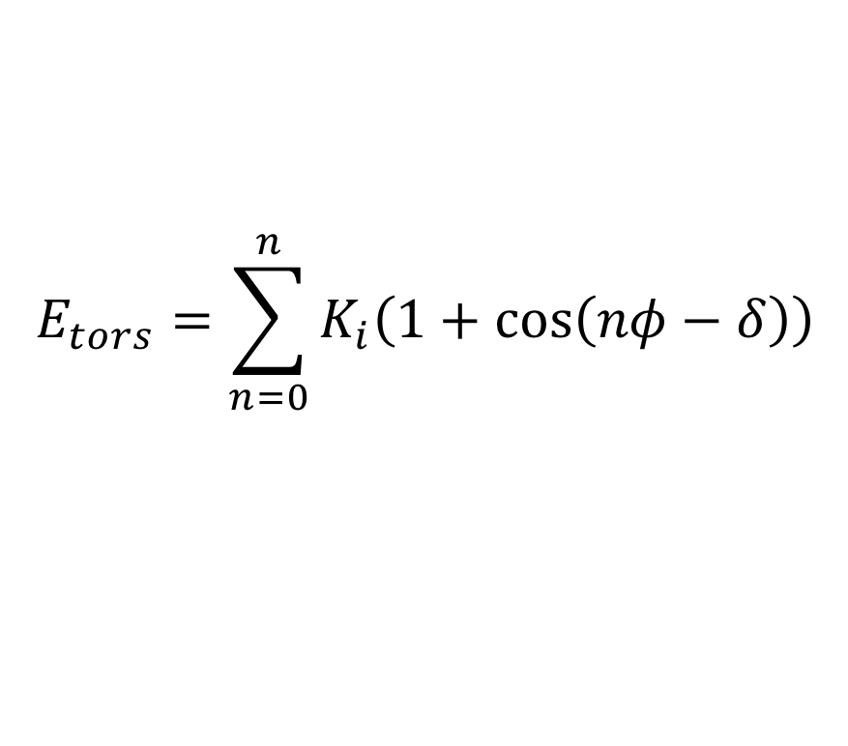
Parameter file: Dihedrals
EXOTIC
CHARMM
DIHEDRALS
!
! V(dihedral) = Kchi(1 + cos(n(chi) - delta))
!
!atom types Kchi(K/mole) n delta(degree)
X CH2 CH2 X 0.000000 0 0.0 !
X CH2 CH2 X 355.029964 1 0.0 !
X CH2 CH2 X -68.189775 2 180.0 !
X CH2 CH2 X 791.317812 3 0.0 !
DIHEDRALS
!
! V(dihedral) = Kchi(1 + cos(n(chi) - delta))
!
!atom types Kchi(Kcal/mole) n delta(degree)
X CH2 CH2 X 0.000000 0 0.0 !
X CH2 CH2 X 0.705517 1 0.0 !
X CH2 CH2 X -0.135507 2 180.0 !
X CH2 CH2 X 1.572510 3 0.0 !
$$E_{tors}=\sum_{n=0}^{n}{K_{i}\left(1+\cos\left(nφ−δ\right)\right)}$$

Slide 34
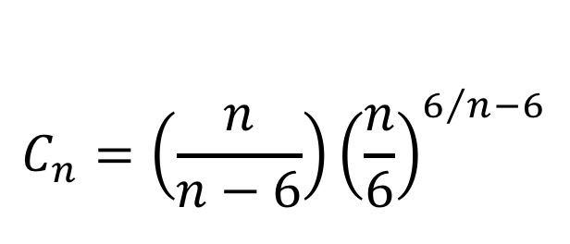
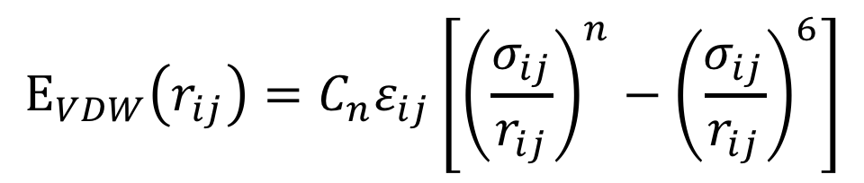
Parameter file: Nonbonded
EXOTIC
NONBONDED_MIE
!
! V(mie) = 4*eps*((sig_ij/r_ij)^n-(sig_ij/r_ij)^6)
!
!atom type eps(K) sigma(A) n eps,1-4(K) sigma,1-4(A) n,1-4 !description
CH4 161.00 3.740 14 0.00 0.000 0 ! Mie
CH3 121.25 3.783 16 0.00 0.000 0 ! Mie
CH2 61.00 3.990 16 0.00 0.000 0 ! Mie
$$E_{VDW}\left(r_{ij}\right)=C_{n}ε_{ij}\left[{\left(\frac{σ_{ij}}{r_{ij}}\right)}^{n}−{\left(\frac{σ_{ij}}{r_{ij}}\right)}^{6}\right]$$
$$C_{n}=\left(\frac{n}{n−6}\right){\left(\frac{n}{6}\right)}^{6/n−6}$$

Slide 35
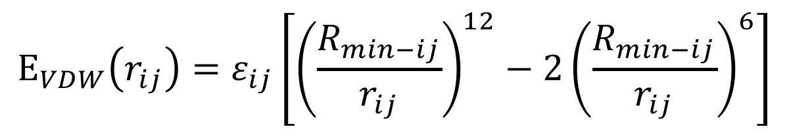
Parameter file: Nonbonded
CHARMM
NONBONDED
!
! V(LJ) = eps,i,j[(Rmin,i,j/ri,j)**12 - 2(Rmin,i,j/ri,j)**6]
!
!atom type ignored eps(Kcal/mol) Rmin/2(A) ignored eps,1-4(Kcal/mol) Rmin/2,1-4(A) !description
CH4 0.0 -0.294106207 2.093391720 0.0 0.00 0.00 ! TraPPE 1
CH3 0.0 -0.194746002 2.104616341 0.0 0.00 0.00 ! TraPPE 1
CH2 0.0 -0.091411389 2.216862545 0.0 0.00 0.00 ! TraPPE 1
$$E_{VDW}\left(r_{ij}\right)=ε_{ij}\left[{\left(\frac{R_{min−ij}}{r_{ij}}\right)}^{12}−2{\left(\frac{R_{min−ij}}{r_{ij}}\right)}^{6}\right]$$

Slide 36
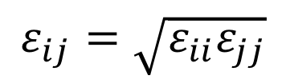
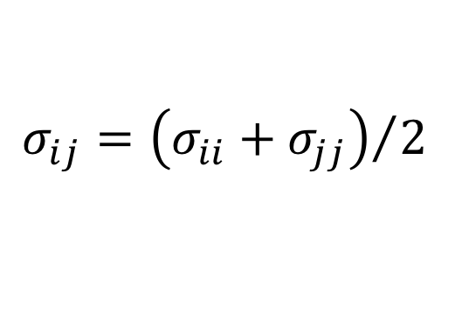
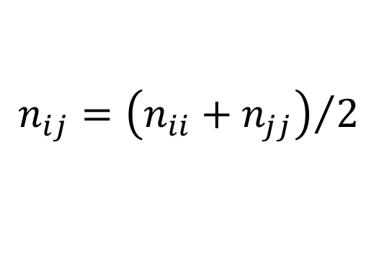
Parameter file: Nonbonded Fix (adsorbates)
EXOTIC
NBFIX_MIE
!
! V(mie) = 4*eps*((sig_ij/r_ij)^n-(sig_ij/r_ij)^6)
!
!type1 type2 eps(K) sigma(A) n eps,1-4(K) sigma,1-4(A) n,1-4 !description
C C 0.00 0.000 0 0.00 0.000 0 !
C H 0.00 0.000 0 0.00 0.000 0 !
C O 0.00 0.000 0 0.00 0.000 0 !
C ZN 0.00 0.000 0 0.00 0.000 0 !
$$σ_{ij}={\left(σ_{ii}+σ_{jj}\right)}/2$$
$$ε_{ij}=\sqrt{ε_{ii}ε_{jj}}$$
$$n_{ij}={\left(n_{ii}+n_{jj}\right)}/2$$

Slide 37
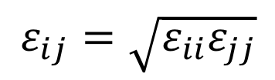
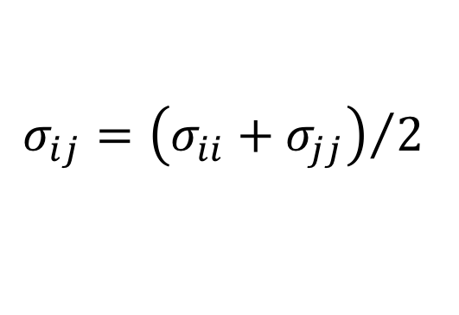
Parameter file: Nonbonded Fix (adsorbates)
CHARMM
NBFIX
!
! V(LJ) = Eps,i,j[(Rmin,i,j/ri,j)**12 - 2(Rmin,i,j/ri,j)**6]
!
! type1 type2 ignored eps(Kcal/mol) Rmin(A) ignored eps,1-4(Kcal/mol) Rmin,1-4(A) !description
C C 0.0 0.000 0.000 0.0 0.00 0.00 !
C H 0.0 0.000 0.000 0.0 0.00 0.00 !
C O 0.0 0.000 0.000 0.0 0.00 0.00 !
C ZN 0.0 0.000 0.000 0.0 0.00 0.00 !
$$σ_{ij}={\left(σ_{ii}+σ_{jj}\right)}/2$$
$$ε_{ij}=\sqrt{ε_{ii}ε_{jj}}$$
NOTE: CHARMM uses Rmin rather than Rmin/2

Slide 38
Build initial configuration
300 K, 0.5672 g/cm³ (saturated liquid density); 1000 molecules -> L~55.4 A
tolerance 3.0
filetype pdb
output packed_argon.pdb
Structure ./singleMolecule/argon.pdb
number 1000
inside cube 0.1 0.1 0.1 37.
end structure
tolerance 3.0
filetype pdb
output packed_butane.pdb
Structure butane_ua2.pdb
number 1000
inside cube 2. 2. 2. 53. 53. 53.
end structure
./packmol <pack_box_0.inp

Slide 39
Build PSF
Argon
Butane
psfgen<<ENDMOL
topology ./top_NobleGases.inp
segment AR {
pdb ./packed_argon.pdb
first none
last none
}
coordpdb ./packed_argon.pdb AR
writepsf ./START_BOX_0.psf
writepdb ./START_BOX_0.pdb
psfgen<<ENDMOL
topology ./top_mie.inp
segment C4A {
pdb ./packed_butane.pdb
auto angles dihedrals
first none
last none
}
coordpdb ./packed_butane.pdb C4A
writepsf ./START_BOX_0.psf
writepdb ./START_BOX_0.pdb
Notes:
Auto angles dihedrals tells psfgen to automatically generate the required angle and dihedral information.

Slide 40
Modify control file
Argon
Butane
ParaTypeEXOTIC true
Parameters ./par_NobleGases_Mie.par
# MOVE FREQUENCY
DisFreq 0.90
RotFreq 0.00
IntraSwapFreq 0.10
RegrowthFreq 0.00
# BOX DIMENSION #, X, Y, Z
CellBasisVector1 0 38.527 0.00 0.00
CellBasisVector2 0 0.00 38.527 0.00
CellBasisVector3 0 0.00 0.00 38.527
# CBMC TRIALS
CBMC_First 8
CBMC_Nth 6
CBMC_Ang 0
CBMC_Dih 0
ParaTypeEXOTIC true
Parameters ./par_mie.inp
# MOVE FREQUENCY
DisFreq 0.60
RotFreq 0.10
IntraSwapFreq 0.10
RegrowthFreq 0.20
# BOX DIMENSION #, X, Y, Z
CellBasisVector1 0 55.41 0.00 0.00
CellBasisVector2 0 0.00 55.41 0.00
CellBasisVector3 0 0.00 0.00 55.41
# CBMC TRIALS
CBMC_First 8
CBMC_Nth 6
CBMC_Ang 100
CBMC_Dih 100
Notes:
Auto angles dihedrals tells psfgen to automatically generate the required angle and dihedral information.

Slide 41
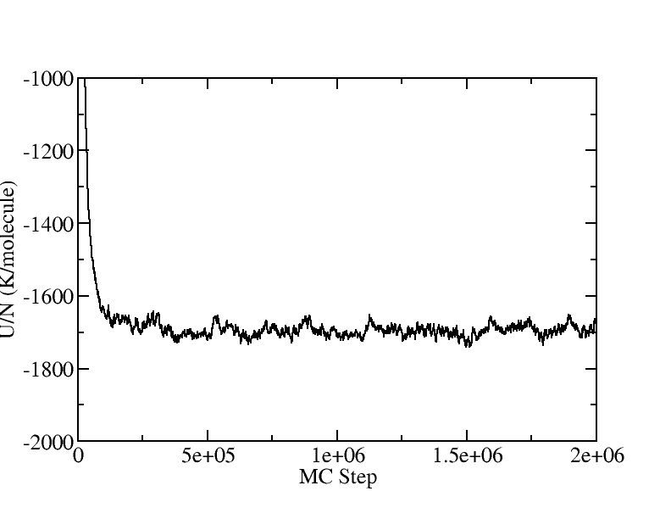
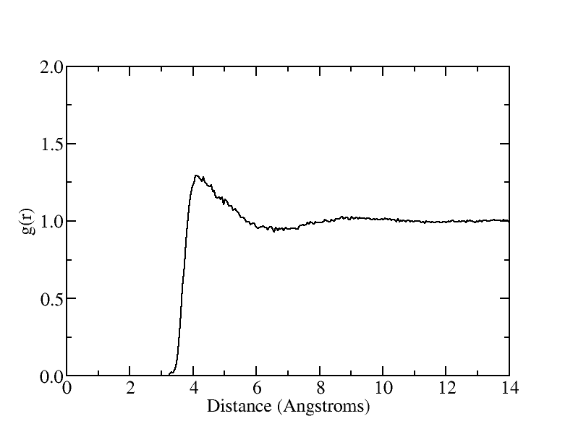
Butane NVT at 300K and 0.567 g/cm³
CH₃-CH₃ interactions

Slide 42

Gibbs Ensemble Monte Carlo
Particle Displacement
Volume Exchange
Bulk liquid and vapor
External (NVT): N_{T}, V_{T}, T are constant Chemical equilibrium: μ_{L}= μ_{V}
Mechanical Equlibrium: P_{V}=P_{L}
Molecule Transfer

Slide 43
GEMC Example
Workshop/NVT_GEMC
Need to build initial configurations for two boxes.
Issuing the following commands to create START_BOX_*.pdb, *.psf
./packmol <pack_box_0.inp
./packmol <pack_box_1.inp
./build_psf_box_0.tcl or try vmd < build_ps_box_0.tcl
./build_psf_box_1.tcl or try vmd < build_ps_box_1.tcl
Could be combined into a single shell script.

Slide 44
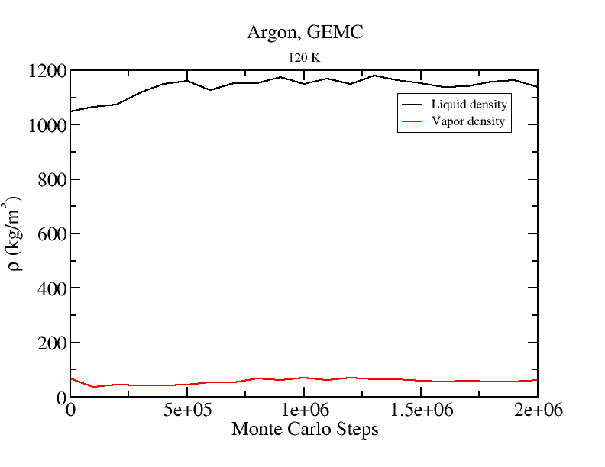
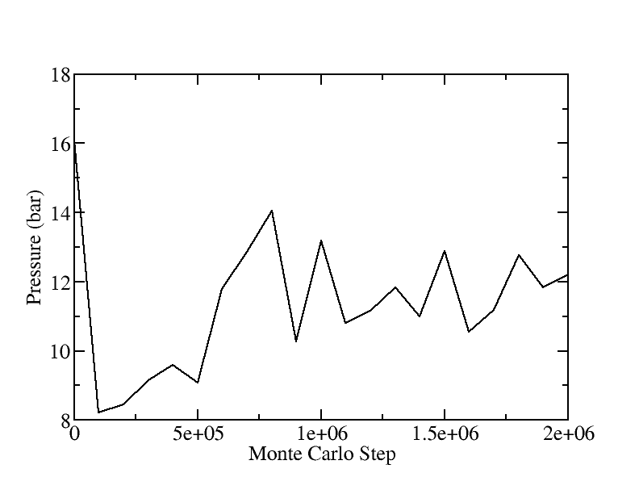
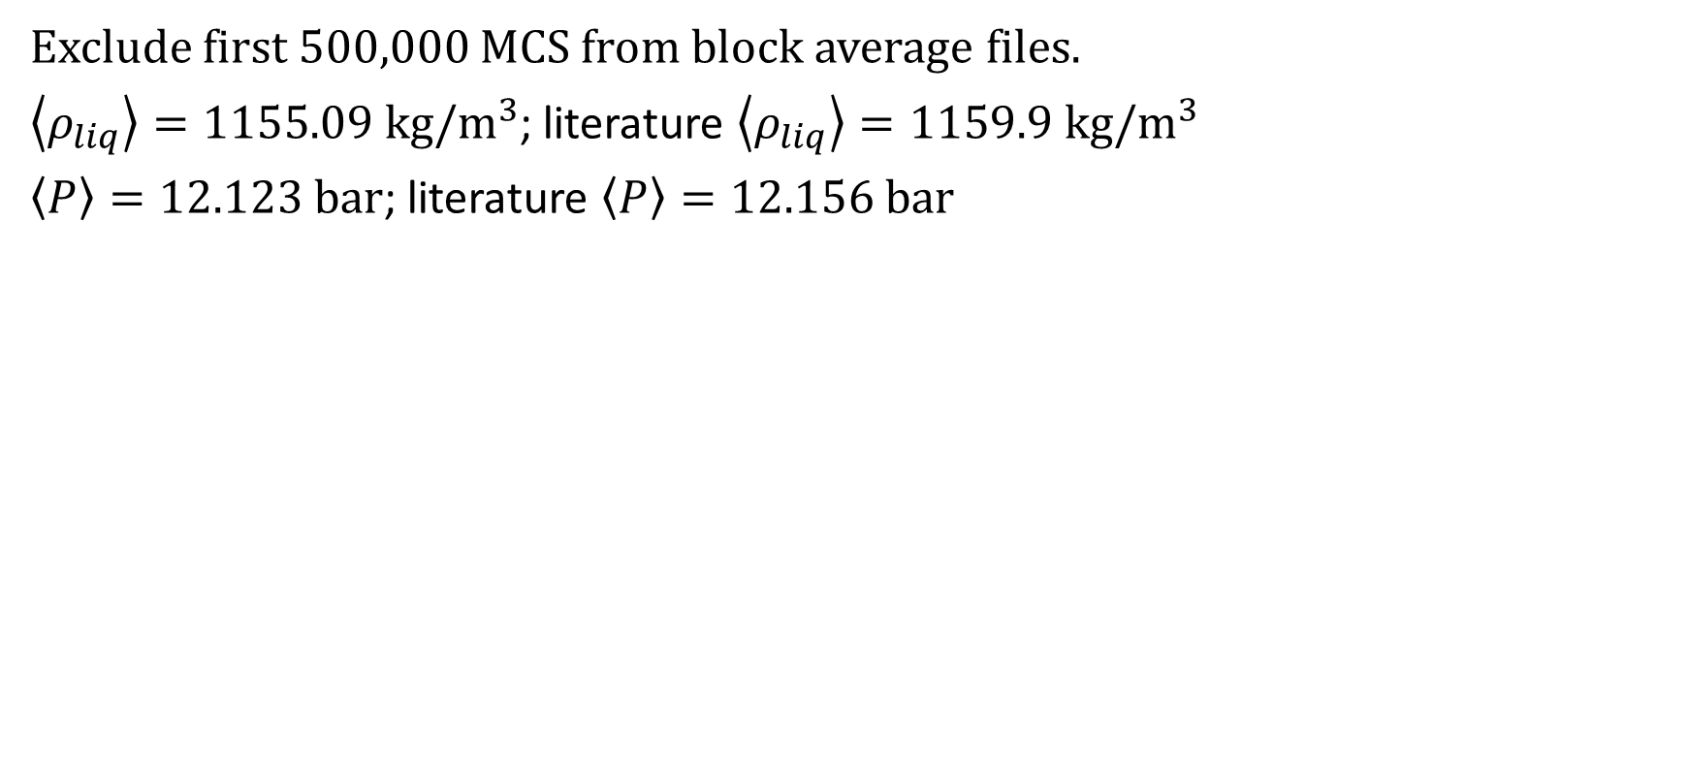
GEMC: Argon 120 K
Exclude first 500,000 MCS from block average files.
$\left\langle ρ_{liq}\right\rangle =1155.09 kg/m^{3}$; literature $\left\langle ρ_{liq}\right\rangle =1159.9 kg/m^{3}$
$\left\langle P\right\rangle =12.123 bar$; literature $\left\langle P\right\rangle =12.156 bar$

Slide 45
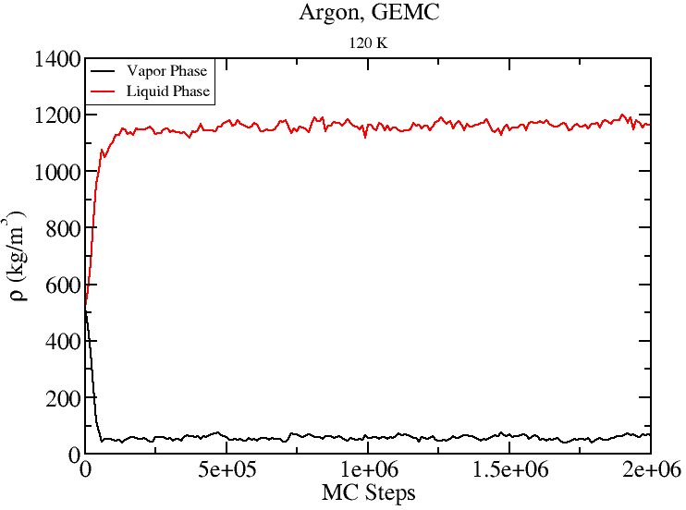
GEMC: Argon 120K
Start from 500 molecules and L=40 A
for each box.
As long as one starts in the two phase region, GEMC will form two distinct phases.
Gas
Gas
Liquid
Liquid

Slide 46
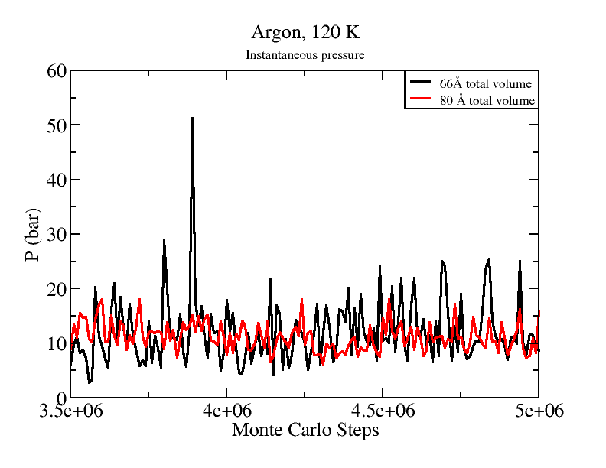
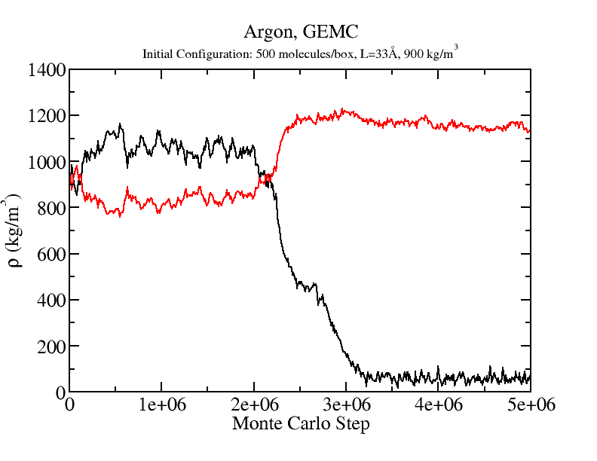
GEMC Tips
Choice of simulation parameters may effect length of equilibration required.
Number of molecules in each phase also effects the magnitude of the statistical uncertainties.

Slide 47
GEMC: Restart files
For GEMC, the “merged” PSF file written by GOMC contains the information for both boxes.
####################################
# INPUT PSF FILES
####################################
Structure 0 ../argon_T_120K/Argon_GEMC_T_120K_merged.psf
Structure 1 ../argon_T_120K/Argon_GEMC_T_120K_merged.psf

Slide 48
GEMC PDB Output
“restart” PDB contains only the coordinates for atoms in that phase.
PDB output files for each box contain coordinates for all molecules in the simulation: Argon_GEMC_T_120K_BOX_0.pdb
The occupancy column is used to designate the box to which each molecule belongs. “imaginary” molecules are given coordinates of 0,0,0.
ATOM 29 AR AR A 29 21.324 0.131 25.770 0.00 0.00
ATOM 30 AR AR A 30 29.973 1.108 36.433 0.00 0.00
ATOM 31 AR AR A 31 0.000 0.000 0.000 1.00 0.00
Unfortunately, VMD does not understand changing the number of molecules in the simulation. VMD also does not update occupancy values.

Slide 49
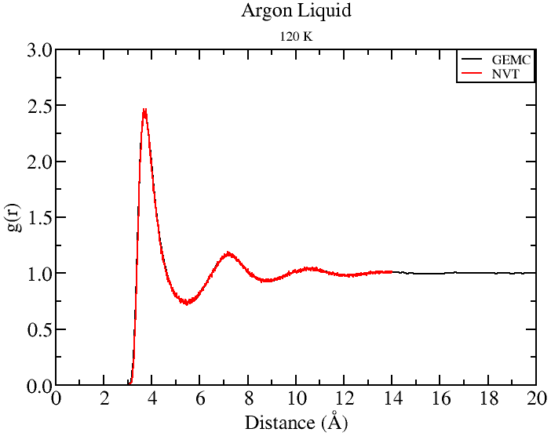
GEMC PDB Output
#set selection to ignore all molecules with 0, 0, 0 coordinates.
set AllSel1 [atomselect top "name $sel1 and x != 0.0 and y != 0.0 and z !=0.0" frame $j]
set AllSel2 [atomselect top "name $sel2 and x != 0.0 and y != 0.0 and z !=0.0" frame $j]
set BoxL [lindex $BoxDim 0 $j]
pbc set "$BoxL $BoxL $BoxL“
#calculate RDF
set temRDF [measure gofr $AllSel1 $AllSel2 delta $stepSize rmax $rcut usepbc 1]

Slide 50
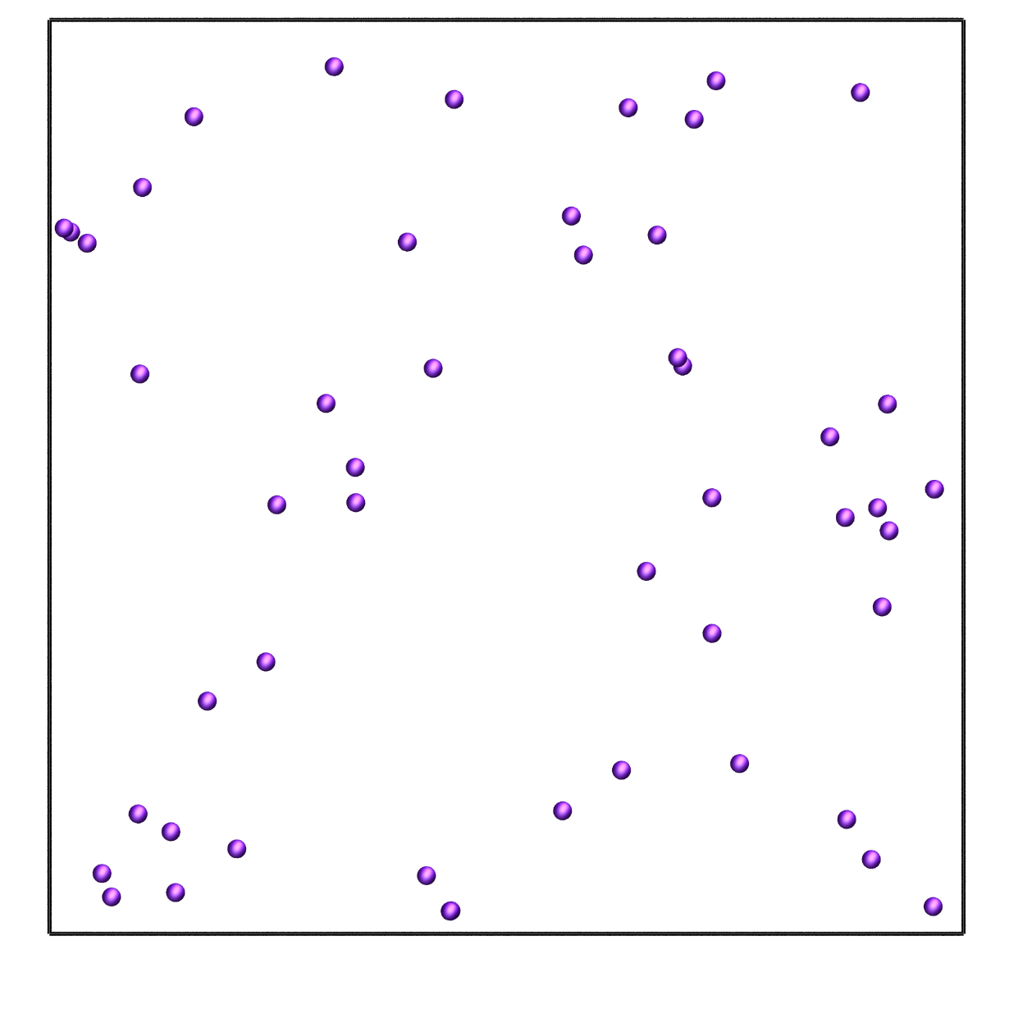
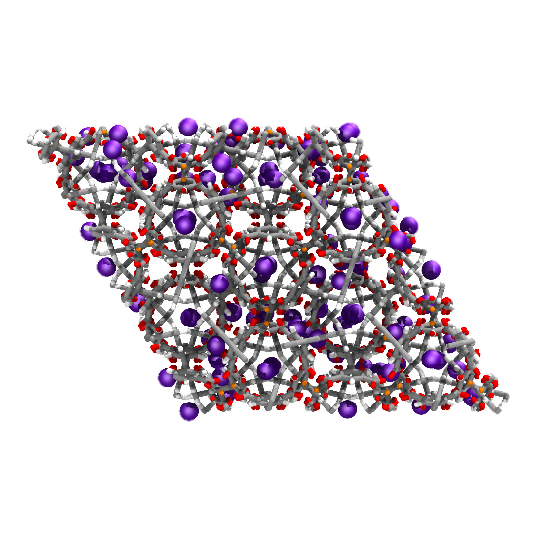



Grand Canonical Monte Carlo
External (μVT): μ, V, T are constant and imposed by reservoir on simulation box. Fluctuating: N, P, and E .
$$p_{m}=\frac{{\frac{V^{N}}{N!}e}^{−βE_{m}+βμN}}{\sum_{N}{\frac{V^{N}}{N!}\sum_{n}{e^{−βE_{n}+βμN}}}}=p_{m}=\frac{e^{−βE_{n}+βμN}}{Ξ\left(μ,V, T\right)}$$
$$\frac{p_{N→N+1}^{ACC}}{p_{N+1→N}^{ACC}}=\frac{\frac{{\frac{V^{N+1}}{N+1!}e}^{−βE_{n+1}+βμ(N+1)}}{Ξ\left(μ,V, T\right)}}{\frac{V^{N}}{N!}\frac{e^{−βE_{n}+βμN}}{Ξ\left(μ,V, T\right)}}={\frac{V}{N+1}e}^{−β\left(U_{n+1}−U_{n}\right)+βμ}$$
$$\frac{p_{N→N−1}^{ACC}}{p_{N−1→N}^{ACC}}=\frac{\frac{{\frac{V^{N−1}}{N−1!}e}^{−βE_{n−1}+βμ(N−1)}}{Ξ\left(μ,V, T\right)}}{\frac{\frac{V^{N}}{N!}e^{−βE_{n}+βμN}}{Ξ\left(μ,V, T\right)}}={\frac{N}{V}e}^{−β\left(U_{n−1}−U_{n}\right)−βμ}$$

Slide 51


Grand Canonical Monte Carlo
Acceptance criteria for molecule swap in Grand Canonical ensemble Monte Carlo (GCMC).
$$P_{N→N+1}^{ACC}=\min\left[1, {\frac{V}{N+1}e}^{βμ−β\left(U_{n+1}−U_{n}\right)}\right]$$
$$P_{N→N−1}^{ACC}=\min\left[1, {\frac{N}{V}e}^{−βμ−β\left(U_{n−1}−U_{n}\right)}\right]$$

Slide 52






Grand Canonical Monte Carlo
For ideal gas:
$$μ=μ^{°}+RT ln\left(\frac{p}{p^{°}}\right)$$
For non-ideal gas:
$$μ=μ^{°}+RT ln\left(\frac{f}{p^{°}}\right)$$
$${{f=p}^{°}e}^{β\left(μ−μ^{°}\right)}$$
$$P_{N→N+1}^{ACC}=\min\left[1, {\frac{Vβf}{N+1}e}^{−β\left(U_{n+1}−U_{n}\right)}\right]$$
$$P_{N→N−1}^{ACC}=\min\left[1, {\frac{N}{Vβf}e}^{−β\left(U_{n−1}−U_{n}\right)}\right]$$

Slide 53
Creating PDB, PSF for reservoir:
GCMC requires two simulation boxes, one for the reservoir and the other for the adsorbent.
To prepare the reservoir, we use 1000 argon molecules in 40 Å cubic box.
tolerance 3.0
filetype pdb
output packed_argon.pdb
Structure ./singleMolecule/argon.pdb
number 1000
inside cube 0.1 0.1 0.1 38.
end structure
psfgen<<ENDMOL
topology ../topology_EDUSIF.inp
segment AR {
pdb ./packed_argon.pdb
first none
last none
}
coordpdb ./packed_argon.pdb AR
writepsf ./START_BOX_1.psf
writepdb ./START_BOX_1.pdb

Slide 54






Creating PDB for adsorbent:
Beta = 0: Displace, Rotate, Intra-swap, Swap, regrowth
Beta = 1: Fix
Beta = 2: Displace, Rotate, Intra-swap, regrowth
Beta Value
Tcl script in VMD
Notes:
Code uses the PDB values in the PDB to determine if a particular molecule should be moved or not.

Slide 55


Creating PDB for adsorbent:
To generate the PDB file, each atom will be considered its own molecule. Assign resname using atom name.
Download the crystal structure.
Use VESTA to:
Extend the unit cell by factor of 2.
Remove the bonds.
Export the structure as PDB file.
Use convert script to assign resname and resid based on atom name.

Slide 56
Building “Base”
vmd < convert_VESTA_PDB.tcl
vmd < build_EDUSIF_auto.tcl
vmd < setBeta.tcl

Slide 57


Creating PSF for adsorbent:
To generate the PSF file, separate each residue in each file and use psfgen to generate PSF file.
Use build scripts (convert_VESTA_PDB.tcl, build_EDUSIF_auto.tcl) to separate each residue type and generate PDB files.
Set beta value to 1 in PDB by using setBeta.tcl script.

Slide 58
Creating PSF for adsorbent:
package require psfgen
topology ../topology_EDUSIF.inp
exec grep -w "Zn" EDUSIF_clean_min_modified.pdb > ZN.pdb
exec grep -w "C" EDUSIF_clean_min_modified.pdb > C.pdb
exec grep -w "O" EDUSIF_clean_min_modified.pdb > O.pdb
exec grep -w "H" EDUSIF_clean_min_modified.pdb > H.pdb
segment Zn {
pdb ZN.pdb
first none
last none
}
segment C {
pdb C.pdb
first none
last none
}
segment O {
pdb O.pdb
first none
last none
}
segment H {
pdb H.pdb
first none
last none
}
coordpdb ZN.pdb Zn
coordpdb C.pdb C
coordpdb O.pdb O
coordpdb H.pdb H
writepsf IRMOF_1_BOX_0.psf
writepdb IRMOF_1_BOX_0.pdb

Slide 59
IRMOF-1 Topology file:
MASS 1 O 15.999 O !
MASS 2 C 12.0107 C !
MASS 3 H 1.00794 H !
MASS 4 ZN 65.38 ZN !
MASS 5 AR 39.948 AR !
DEFA FIRS none LAST none
AUTOGENERATE ANGLES DIHEDRALS
RESI C 0.000
GROUP
ATOM C C 0.000
PATCHING FIRS NONE LAST NONE
RESI H 0.000
GROUP
ATOM H H 0.000
PATCHING FIRS NONE LAST NONE
RESI O 0.000
GROUP
ATOM O O 0.000
PATCHING FIRS NONE LAST NONE
RESI Zn 0.000
GROUP
ATOM Zn ZN 0.000
PATCHING FIRS NONE LAST NONE
RESI AR 0.00 ! argon
GROUP
ATOM AR AR 0.00 ! *
PATCHING FIRS NONE LAST NONE
END

Slide 60

Control file: GCMC
ParaTypeEXOTIC true
Parameters ./par_IRMOF_NobleGases_Mie.par
# INPUT PDB, PSF FILES
Coordinates 0 ../build/base/IRMOF_1_BOX_0.pdb
Coordinates 1 ../build/reservoir/START_BOX_1.pdb
Structure 0 ../build/base/IRMOF_1_BOX_0.psf
Structure 1 ../build/reservoir/START_BOX_1.psf
# MOVE FREQUENCY
DisFreq 0.20
RotFreq 0.00
IntraSwapFreq 0.20
RegrowthFreq 0.0
SwapFreq 0.60
# Chemical Potential/Fugacity
Fugacity AR 5.0
Fugacity C 0
Fugacity H 0
Fugacity O 0
Fugacity ZN 0
# BOX DIMENSION #, X, Y, Z
CellBasisVector1 0 36.8140 0.0 0.0
CellBasisVector2 0 18.2583 31.9880 0.0
CellBasisVector3 0 18.2712 10.5596 30.1748
CellBasisVector1 1 40.00 0.00 0.00
CellBasisVector2 1 0.00 40.00 0.00
CellBasisVector3 1 0.00 00.00 40.00
# OutHistSettings
DistName dis
HistName his
RunNumber 1
RunLetter a
SampleFreq 200
Vector1$=\left(1, 0, 0\right)x$
Vector2 $=$ $\left(\cos{γ}, \sqrt{1−{\left(\cos{γ}\right)}^{2}}, 0\right)y$
Vector3 $=$ $\left(\cos{β}, \frac{\cos{α}−\cos{β\cos{γ}}}{\sqrt{1−{\left(\cos{γ}\right)}^{2}}},\sqrt{1−{\left(\cos{β}\right)}^{2}−{\left(\frac{\cos{α}−\cos{β\cos{γ}}}{\sqrt{1−{\left(\cos{γ}\right)}^{2}}}\right)}^{2}} \right)z$

Slide 61

Argon Adsorption in IRMOF-1

Slide 62


NPT-GEMC Example
The Gibbs ensemble method can be used to compute adsorption isotherms in nanoporous materials. One of the boxes contains the framework, while the other box contains the fluid phase (either gas or liquid) that is in equilibrium with the adsorbed phase. The fluid-phase box is maintained at constant pressure (and temperature) by applying volume moves

Slide 63
Comparing control files:
NVT-GEMC
NPT-GEMC
# GEMC TYPE (DEFULT IS NVT_GEMC)
GEMC NVT
# MOVE FREQUENCY
DisFreq 0.68
RotFreq 0.00
IntraSwapFreq 0.10
SwapFreq 0.20
VolFreq 0.02
# BOX DIMENSION #, X, Y, Z
CellBasisVector1 0 37.00 0.00 0.00
CellBasisVector2 0 0.00 37.00 0.00
CellBasisVector3 0 0.00 0.00 37.00
CellBasisVector1 1 58.00 0.00 0.00
CellBasisVector2 1 0.00 58.00 0.00
CellBasisVector3 1 0.00 0.00 58.00
# GEMC TYPE (DEFULT IS NVT_GEMC)
GEMC NPT
Pressure 5.0
FixVolBox0 true
# MOVE FREQUENCY
DisFreq 0.48
RotFreq 0.00
IntraSwapFreq 0.20
SwapFreq 0.30
VolFreq 0.02
# BOX DIMENSION #, X, Y, Z
CellBasisVector1 0 36.8140 0.0 0.0
CellBasisVector2 0 18.2583 31.9880 0.0
CellBasisVector3 0 18.2712 10.5596 30.1748
CellBasisVector1 1 103.00 0.00 0.00
CellBasisVector2 1 0.00 103.00 0.00
CellBasisVector3 1 0.00 00.00 103.00

Slide 64




Histogram Methods
$$P\left(N_{1}, …,N_{n}, E\right)=\frac{Ω{\left(N\right.}_{1}, …,N_{n}, V, E)×exp⁡(−βE+\sum_{i=1}^{n}{\left.β{μ_{i}N}_{i}\right)}}{\left.Ξ{\left(μ\right.}_{1}, …,μ_{n}, V,E\right)}$$
$$P=\frac{k_{B}T}{V}ln{Ξ\left(μ,V,T\right)+C}$$
The constant $C$ is determined by extrapolating the predicted partition function to very low densities, where the system exhibits ideal gas behavior.
Locate coexistence by varying $μ$ until equal area is obtained under each peak of the distribution.

Slide 65


One component VLE from histograms
Find the “bridge” between phases near the critical point.
Run gas phase simulations to determine the constant in
Predict VLE, use reweighted data to determine the run conditions for the next simulations.
$$P=\frac{k_{B}T}{V}ln{Ξ\left(μ,V,T\right)+C}$$

Slide 66

GOMC on Multicore and GPU

Slide 67
GOMC on multicore CPUs
If you have openMP installed, on Linux GOMC will autodetect and compile with support for multicore execution.
https://software.intel.com/en-us/c-compilers/ipsxe
Running on multicore (4 CPU cores)
GOMC_CPU_GEMC +p4 input file > log file
Biggest performance gains are for GEMC and NPT ensembles, for systems that use the Ewald summation.
GCMC sees little performance gain on multicore.

Slide 68
GOMC on GPU
GOMC will automatically detect and compile support for GPUs on Linux if the CUDA development kit is installed.
https://developer.nvidia.com/cuda-toolkit
GPU executables are named GOMC_GPU_ensemble
GPU executables also include multicore support.
Biggest performance gain is for GEMC for systems that use the Ewald summation.

Slide 69


GOMC performance
GCMC
GEMC

Slide 70


Cell List
Timing data for NVT Monte Carlo simulations of 2,5-dimethylhexane. Data were generated on one core of an i5-3570K 3.40GH Intel(R) CPU or a NVIDIA K40.
Move type | Percentage
Displacement | 80
Rotation | 20
Notes:
have feature but fastest among other MC codes
in order to achieve this goal, implement cellist
before: loop through all molecule inside sim box, calc distance, rcut => VDW
cellist: looping through surronding box
CPU: 1.7 to 20 times faster 4096 N
GPU: 6 times faster 4096 N

Slide 71
Parallel Optimization
Monte Carlo
Molecular dynamics
Volume move on GPU: O(N²)=> O(N)
1
2
3
4
5
6
All other moves: Not enough work; GPU starves.
7
8
9
CPUs
Need to create more parallel work.
Notes:
MC move one molecule at a time; MD move all molecules at a time.

Slide 72

Ewald Summation
$$U^{Elec}=U^{Real Space}+ U^{Reciprocal Space}−U^{Self}$$
$$U^{Real Space}=\frac{1}{8πε_{0}}\sum_{i=1}^{N}{\sum_{j=1}^{N}{q_{i}q_{j}\frac{ erfc \left(αr_{ij}\right)}{r_{ij}}}}$$
$$U^{Reciprocal Space}=\frac{1}{2Vε_{0}}\sum_{k≠0}{\frac{1}{{\vec{k}}^{2}}e^{−\frac{{\vec{k}}^{2}}{4α^{2}}} \left[{\left|\sum_{i=0}^{N}{q_{i}cos\left(\vec{k}.{\vec{r}}_{i}\right)}\right|}^{2}+{\left|\sum_{i=0}^{N}{q_{i}sin\left(\vec{k}.{\vec{r}}_{i}\right)}\right|}^{2}\right]}$$
$$U^{Self}=\frac{1}{8πε_{0}}\sum_{j=1}^{M}{\sum_{k=1}^{N_{j}}{\sum_{l=1}^{N_{l}}{q_{j_{k}}q_{j_{l}}\frac{ erf \left(αr_{j_{k}j_{l}}\right)}{r_{j_{k}j_{l}}}}}}+\frac{1}{4π^{\frac{3}{2}}ε_{0}}\sum_{i=1}^{N}{{q_{i}}^{2}}$$

Slide 73



GPU Scaling
$$U_{long−range}=\frac{1}{ε_{0}V}\frac{1}{2}\sum_{K≠0}^{†}{\frac{exp⁡(\frac{−πK^{2}}{α^{2}})}{K^{2}}\left[{\left|\sum_{i=1}^{N}{q_{i}cos⁡(\overset{⃑}{K}.\overset{⃑}{x_{i}})}\right|}^{2}+{\left|\sum_{i=1}^{N}{q_{i}sin⁡(\overset{⃑}{K}.\overset{⃑}{x_{i}})}\right|}^{2}\right]}$$
Volume Move:
$T=O\left(\frac{N×N_{cell}}{P}\right)$+$O\left(\frac{N×N}{P}\right)+T_{o}$
For $P=\# of threads≥N$
$$∴T=O\left(N_{cell}\right)+O\left(N\right)+T_{o}$$
Displace, swap, rotate:
$$T=O\left(\frac{N_{cell}}{P}\right)+O\left(\frac{N}{P}\right)+T_{O}$$
For $P=\# of threads≥N$
$$T=C_{1}+C_{2}+T_{o}$$
Notes:
N is number of particles. N2 comes from reciprocal part

Slide 74


NVT on GPU: Dimethylether
$$T=O\left(\frac{N_{cell}}{P}\right)+O\left(\frac{N}{P}\right)+T_{O}$$
OpenMP: 4 cores
1 CPU core + NVIDA K40 GPU
Notes:
Displace and rotation move. 4 CPU openMP vs. 1 CPU and GPU.

Slide 75


GEMC on GPU: Dimethylether
$$T=O\left(N_{cell}\right)+O\left(N\right)+T_{o}$$
OpenMP: 4 cores
1 CPU core + NVIDA K40 GPU
Move distribution: 89% displacement, 10% molecule swap, 1% volume transfer
Notes:
50 times faster 4 CPU cores

Slide 76
Acknowledgements
Mohammad Soroush Barhaghi, Jason Mick, Younes Nejahi, Kamel Rushaidat, Runxuan Jiang, Brock Jackman, Navendu Bhatnagar, Ganesh Kamath, Loren Schwiebert
National Science Foundation CBET-1066661, ACI-1148168, ACI-1642406
NVIDIA, Silicon Mechanics
Grid Computing at WSU

Slide 77


Slide 78

Argon-Krypton Binary Mixture VLE

Slide 79
GEMC Ar-Kr Mixture
# Run the GOMC simulation in NVT for 3 million steps.
# Assuming that GOMC base directory was cloned in your Desktop:
~/Desktop/GOMC/bin/GOMC_CPU_GEMC mixture_GEMC.conf > output_Ar_KR.log &
# You can monitor the simulation by running the following command:
tail -f output_Ar_KR.log
# Wait until simulation finished, then exit command by typing "ctrl C"

Slide 80
GEMC Ar-Kr Mixture
# To extract statistical properties, we can use 'awk' command.
# This command extract and save the mole fraction value for liquid and vapor phase.
cat Blk_AR_KR_GEMC_T_143.15K_BOX_0.dat | awk '{print $1 " " $16}' > molfrac_Ar_liq.dat
cat Blk_AR_KR_GEMC_T_143.15K_BOX_1.dat | awk '{print $1 " " $16}' > molfrac_Ar_vap.dat
cat Blk_AR_KR_GEMC_T_143.15K_BOX_0.dat | awk '{print $1 " " $17}' > molfrac_Kr_liq.dat
cat Blk_AR_KR_GEMC_T_143.15K_BOX_1.dat | awk '{print $1 " " $17}' > molfrac_Kr_vap.dat

Slide 81
Argon-Krypton VLE at 143.15 K
P (bar) | x₁ | y₁
4.553 | 0.000 | 0.000
5.619 | 0.040 | 0.212
7.922 | 0.117 | 0.450
10.520 | 0.213 | 0.616
12.941 | 0.295 | 0.700
15.480 | 0.390 | 0.769
18.196 | 0.482 | 0.820
23.451 | 0.665 | 0.893
25.932 | 0.732 | 0.915
28.353 | 0.804 | 0.937
30.834 | 0.878 | 0.960
32.606 | 0.922 | 0.973
36.038 | 1.000 | 1.000

Slide 82
Simulating different compositions
Need to change the total composition of the system.
Rebuild boxes by changing the number of moles in pack_box_0 and pack_box_1

